Slide 1
Overcoming Key Barriers to Electrification of Full-Service Restaurant Hot Water
CalNEXT Project Team: 2050 Partners, TRC Companies, Frontier Energy
Maya Gantley
Senior Consultant
2050 Partners
Notes:
Brief personal intro
Today I’ll be sharing a progress update on a CalNEXT project that I’ve been leading focused on foodservice water heating system decarbonization
The project team is 2050, TRC, and Frontier – including Amin on this panel

Slide 2
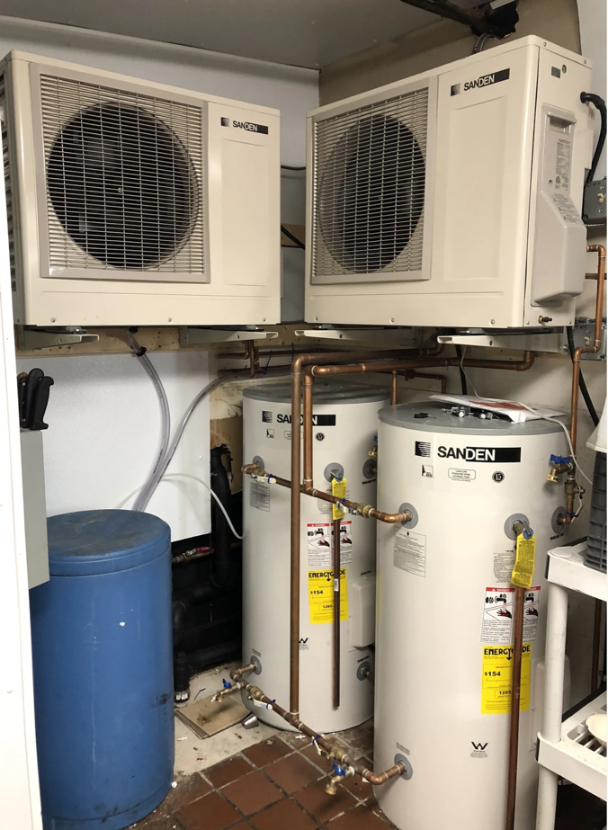
Project Overview
Goals:
Support foodservice hot water system decarbonization
Overcome key barriers: HPWH sizing for full-service restaurants
Research Objectives:
Characterize hot water demand and equipment consumption through field data collection
Engage with key stakeholders
Present field data and alternative water heater sizing approaches to key stakeholders
Image Source: ECO₂ Systems LLC
Notes:
The goal of this project is to support foodservice hot water decarb and dismantle key barriers related to HPWH sizing.
Through this research we aim to:
Characterize full-service restaurant hot water demand and equipment consumption through field data collection.
Develop an alternative foodservice water heater sizing methodology that supports HPWH technology.
Develop recommendations to improve Title 20 and Title 24.
Present field data and alternative sizing guideline to key stakeholders.
Additional notes
Gather data to dismantle a key barrier to commercial kitchen water heating decarbonization, which is water heater sizing guidelines in California that do not account for HPWH technology.
This study has the following objectives to support the project goal:

Slide 3
Key Stakeholders & Collaborators
Air Districts: CARB, South Coast AQMD, Bay Area AQMD
Health and Safety Department Directors, Plan Checkers, and Reviewers
California Conference of Directors of Environmental Health (CCDEH)
Researchers: Code Readiness & CalNEXT

Slide 4
Barriers to HPWH Technology in the Full-Service Foodservice Sector
Market Barriers
High first cost
Lack of familiarity with the technology
Technical Barriers:
Added complexity
Space and ventilation constraints
Limited electrical infrastructure
Noise
Installation challenges: not a one for one replacement
Operating cost
Regulatory Barriers:
Meeting California Retail Food Code sizing requirements: CCDEH Guidelines for Sizing Water Heaters
Notes:
There are numerous barriers to implementing HPWH technology in the foodservice sector, specifically looking at the full-service restaurant:
Market barriers including high first cost and lack of comfort with the technology
There are also critical technical barriers that are not yet solved for the foodservice sector:
Space Constraints: HPWH systems generally require more interior space due to storage tanks and swing tanks, and outdoor space for the heat pump condenser units.
Electrical Infrastructure: foodservice kitchens generally have limited excess panel capacity. Adding load for HPWH and other all-electric cooking equipment would likely require significant infrastructure upgrades and cost (Monsur et al 2022).
Noise: commercial kitchens are already noisy spaces, an additional noise from a HPWH fan could be an additional annoyance or problematic if they raise the noise level above 85 dBA for a prolonged period of time (Fountain et al 2023).
Installation Requirements: there are a number of unique installation requirements for HPWH systems. Those include pipe penetrations to the exterior, condensate drain line, adequate ventilation.
There is also a critical regulatory barrier, which is the CCDEH guidelines for sizing water heaters, which currently does not provide a path for HPWH technology.
*These are particularly important for existing buildings

Slide 5
Barriers to HPWH Technology in the Full-Service Foodservice Sector
Market Barriers
High first cost
Lack of familiarity with the technology
Technical Barriers:
Added complexity
Space and ventilation constraints
Limited electrical infrastructure
Noise
Installation challenges: not a one for one replacement
Operating cost
Regulatory Barriers:
Meeting California Retail Food Code sizing requirements: CCDEH Guidelines for Sizing Water Heaters
A holistically sized HPWH system can address many market and technical barriers:
Optimize storage tanks and minimize recirculation loads to decrease the number of heat pumps:
Lowers first cost
Reduces electrical needs
Reduces noise
Lowers operating cost
Notes:
By taking a holistic approach to sizing water heaters, we can address many of these barriers:
If we use efficient end uses, optimize recirculation loads, and leverage storage tanks for load shifting, we can decrease the number of heat pumps installed:
This lowers first cost, reduces electrical capacity needs, and lowers operating cost
However, one of the main barriers remaining is meeting the health and safety water heater sizing requirements.
NEED to find a spot for this message:
However, there’s also a larger technical and education barrier with the transition to HPWHs. If not sized correctly or holistically, systems will be installed that will operate on just ER, leading to sky high utility costs, or worse not enough HW and unhappy customers

Slide 6
Barriers to HPWH Technology in the Full-Service Foodservice Sector
Market Barriers
High first cost
Lack of familiarity with the technology
Technical Barriers:
Added complexity
Space and ventilation constraints
Limited electrical infrastructure
Noise
Installation challenges: not a one for one replacement
Operating cost
Regulatory Barriers:
Meeting California Retail Food Code sizing requirements: CCDEH Guidelines for Sizing Water Heaters
Notes:
However, one of the main barriers remaining is meeting the health and safety water heater sizing requirements.
NEED to find a spot for this message:
However, there’s also a larger technical and education barrier with the transition to HPWHs. If not sized correctly or holistically, systems will be installed that will operate on just ER, leading to sky high utility costs, or worse not enough HW and unhappy customers

Slide 7
California Retail Food Code & CCDEH
The California Retail Food Code states: “Hot water generation and distribution systems shall be sufficient to meet the peak hot water demands throughout the food facility.”
Assigns primary enforcement responsibility to the local enforcement agency.
Nearly all California county enforcement agencies point to the CCDEH Guidelines for Sizing Water Heaters.
California Conference of Directors of Environmental Health, CCDEH
A non-profit organization whose membership is comprised of Environmental Health Directors from 62 jurisdictions, including all 58 California counties and 4 California cities
Food Policy Committee developed guidelines to support jurisdiction review of water heater sizing.
California Retail Food Code: Chapter 7, Article 1, Section 114194 (b)
https://www.ccdeh.com/
Notes:
Walk through slide
*correct sources

Slide 8
CCDEH Guidelines for Sizing Water Heaters
Objective: ensure the water heater recovery rate meets the peak one-hour hot water demand (GPH).
Sizing Requirements for Storage Water Heaters:
Identify facility peak demand:
Identify all hot water end uses and calculate peak demand (GPH) using reference tables or equipment specs.
https://www.ccdeh.com/
Notes:
Walk through slide

Slide 9
CCDEH Guidelines for Sizing Water Heaters
Sizing Requirements for Storage Water Heaters:
2. With the GPH in hand, you then determine the input rate of the water heater.
kW Input Calculation for Electric Storage Water Heater
$$kW Input=\frac{Heat Recovery Rate \left(GPH\right) ×{ T}_{Rise required}\left(°F\right) × \frac{8.33lb}{gal. }\left(\begin{aligned}Density \\ of water\end{aligned}\right)}{Thermal Efficiency × 3,412\left(\frac{BTU}{kW}\right)}$$
3. Designers must then submit a water heater with
equal or higher input rate (kW for electric).
For the electric thermal efficiency, the default is 98%.
https://www.ccdeh.com/
Notes:
Walk through slide

Slide 10
CCDEH Guidelines for Sizing Water Heaters
Simplified calculation that works for gas and electric resistance systems
Gaps Include:
Doesn’t account for higher HPWH COP
Doesn’t factor in elements that impact COP including recirculation
Doesn’t account for storage tank capacity
Doesn’t offer a path for hybrid or dual-fuel systems
Notes:
This tool is simplistic, which works just fine for gas and ER systems, but does not open the door for HPWH tech:
Some of the key gaps include it doesn’t consider COP, or storage tank capacity, or for hybrid solutions or dual-fuel systems (which has been an interim solution to gain market support for HPWH tech)

Slide 11
CCDEH Guidelines for Sizing Water Heaters
We recommend the Sizing Guidelines be updated to support HPWH technology:
Update the existing guideline calculations and framework
Engineered approach, or a comprehensive sizing tool
Challenge:
It’s a big leap to go from the simplistic equation to a complex engineered approach.
In the short term, we expect CCDEH and Health Departments to only be comfortable with revisions to the existing framework.

Slide 12
What’s Next?
Support the short-term solution:
Document sizing updates and workshop them with Health Department Directors and CCDEH Technical Advisory Committee.
Support education to plan checkers and installers
Support the long-term solution:
Holistic sizing tool that considers:
Load shifting – to minimize peak electric demand impact
Heat pump location, climate zone, and setpoints
Recirculation and controls
Supplemental heat sources
Gather present-day hot water draw profiles to support sizing recommendations

Slide 13
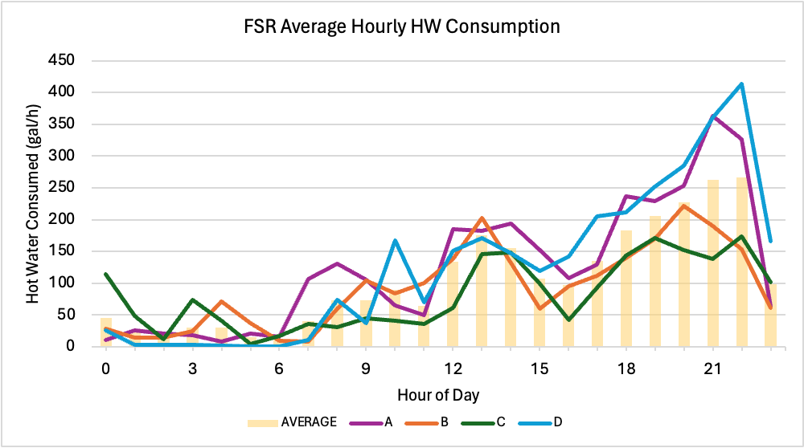
Field Data Collection
We aim to get present-day draw profiles to add to the existing data sets:
3 full-service restaurants
6-9 months starting October 2024
Collecting hot, cold, and recirculation flow data (gpm) and temperature
Equipment hot water draws
Collaboration:
Share data to support lab testing and modeling tools
Full-Service Daily Hot Water Draw Profile
gallons per hour
Notes:
We want to learn about how to optimize the HPWH system and storage size to see how possible it would be to minimize the peak electric demand, avoiding those highlighted hours.
Want to identify operational - cost effective

Slide 14
Key Takeaways
Foodservice water heating system decarbonization requires a multi-prong approach:
Update sizing guidelines to support high-efficient technology
Holistic HPWH sizing tools
Education & Support: Designers, Installers, Owners, and Operators
Research of present-day hot water profiles
Lab testing
HPWH field demonstrations
Notes:
Walk through key findings
A key gap is present day load profiles and data on draws, down to the equipment level. We plan to collect this data very soon to help inform how HPWHs should be sized.

Slide 15
This project is funded by CalNEXT. CalNEXT is a statewide initiative to identify, test, and grow electric technologies and delivery methods to support California’s decarbonized future. Find more information here.
Maya Gantley
Senior Consultant
2050 Partners
mayagantley@2050partners.com

